Slide 1

MCTV Presentation
Group Q: Fouad Animashaun (Leader), Ciaran brady and Yuzhang Chen

Slide 2

Introduction to MCTV
MCTV is a small retail company wanting to expand their business to the cloud.
There’s four areas for investment however only one can get the money, sales, marketing, purchasing, and stock management.
Each group member will be tasked with writing an individual report on why their chosen software should get the investment.

Slide 3
An outline of the tasks
Ayo (Mark)
Group leader
Wordpress site
Richard (Liam)
Presentation
Gantt Chart
Ciaran (Derek)
Microsoft Database
Uml chart
Github
Trello
Microsoft Database
Github
Trello

Slide 4
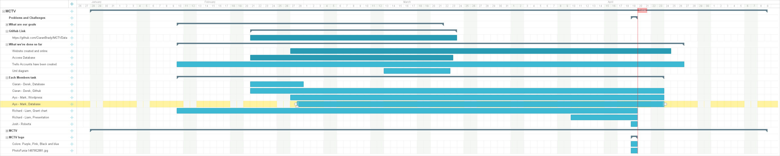
An outline of the tasks via Gantt chart

Slide 5

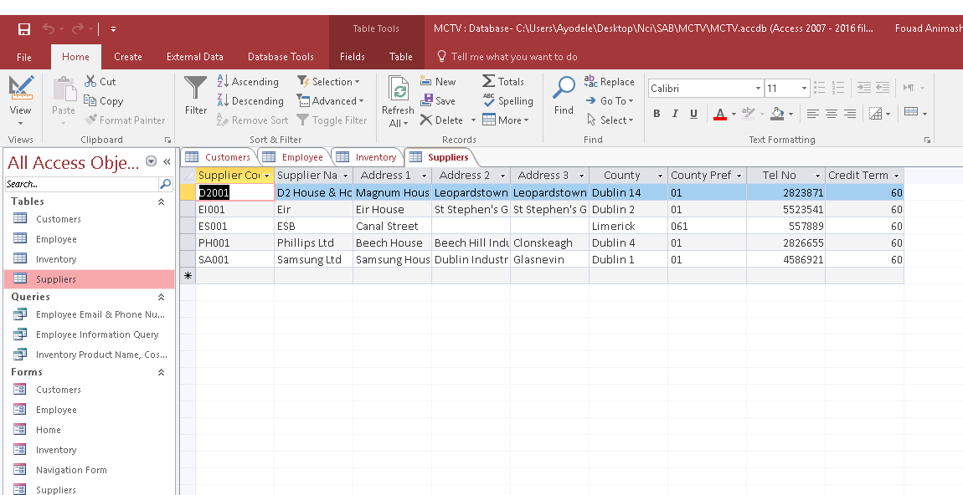

Overview of Database
We decided to create tables, for each of the heading that was in the excel spreadsheet: customers, employees, inventory and suppliers.
You are looking at the Suppliers table. This was done by Mark

Slide 6
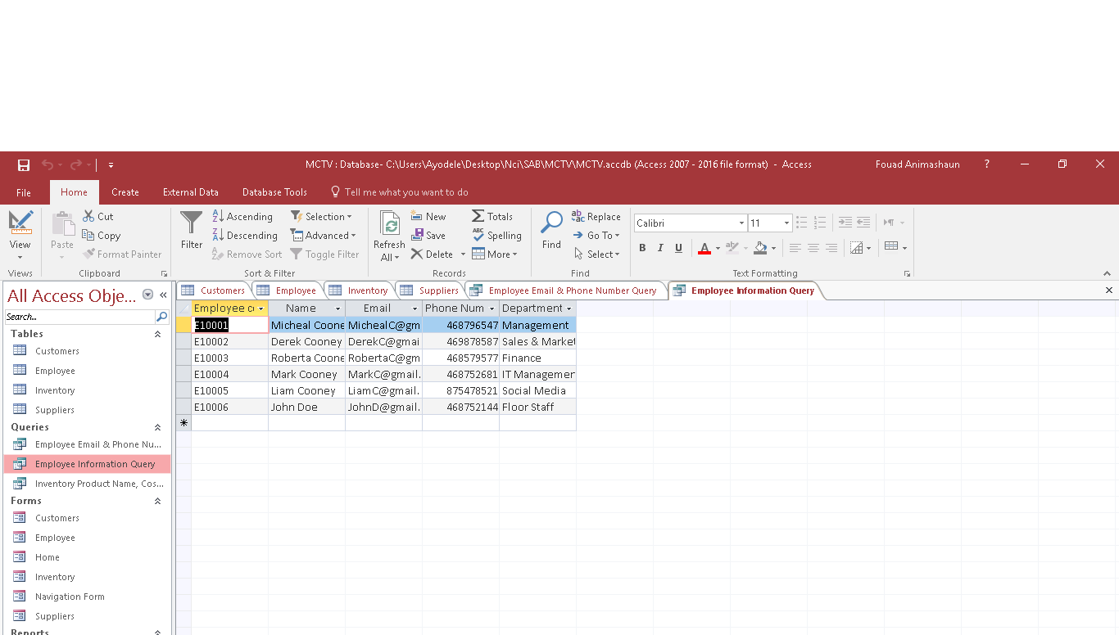

Overview of Database
Under the queries heading we created a table for each of the following headings, Employee email and phone number query, Employee Information query, and inventory product name, cost & quantity in stock query.
You are looking at the Employee information Query. This was done by Liam

Slide 7
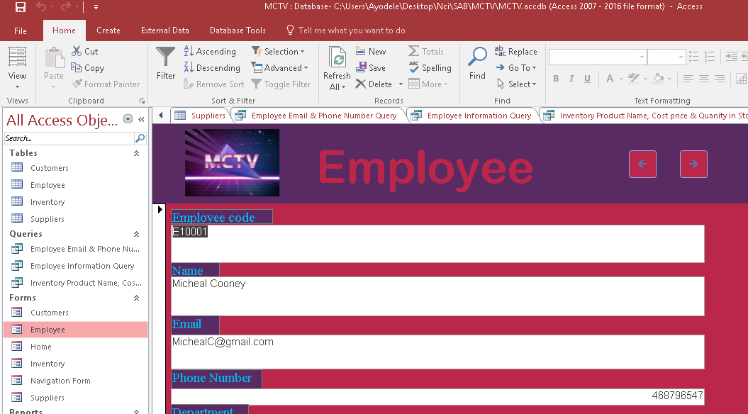
Overview of Database
Here we created forms for easy access of customer, employee and inventory data.
You are looking at the Employee form. This was done by Derek

Slide 8
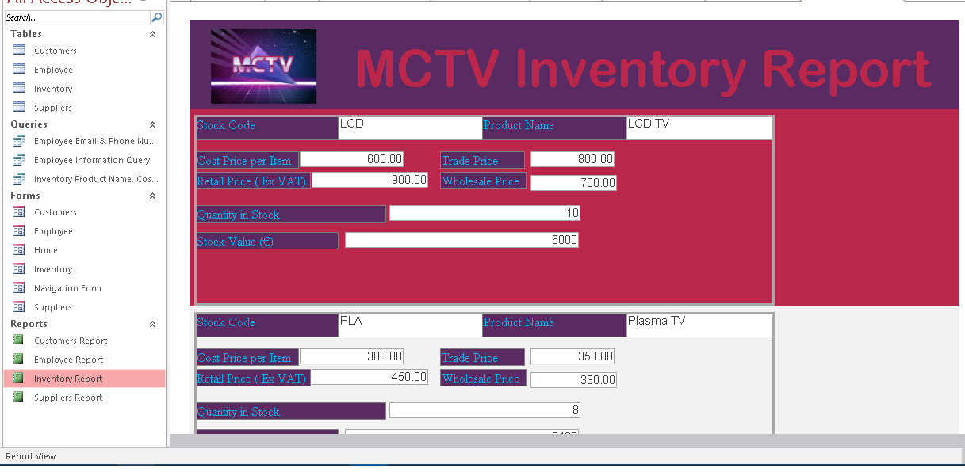

Overview of Database
We have 4 automatically generated report, detailing our suppliers, employees, inventory and customers.
You are looking at the Inventory report. This was done by Derek.

Slide 9
Overview of UML
Done by Mark

Slide 10
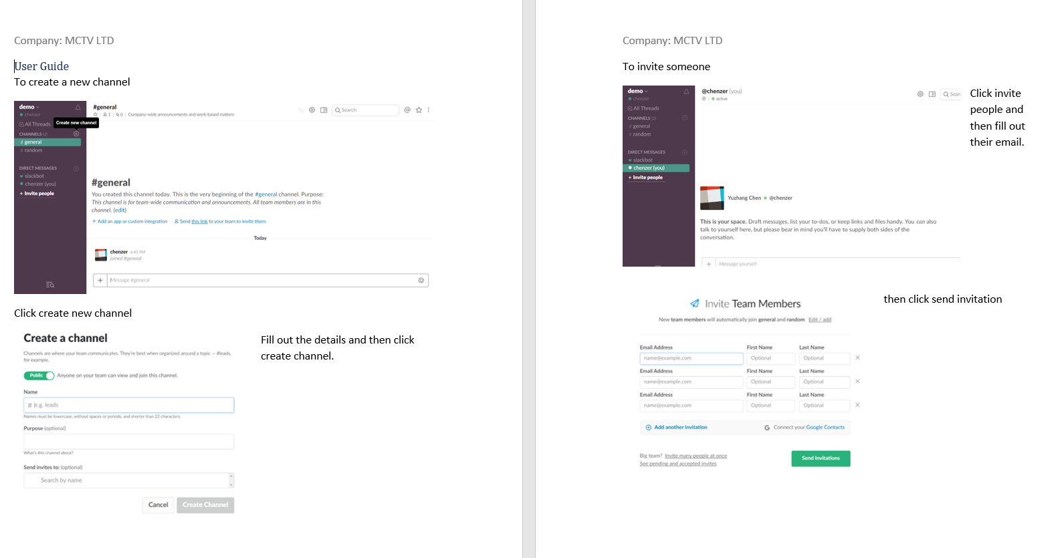
User guides
As Liam of the company I decided to do my user guide on Slack.
I showed how to do simple tasks in slack such as creating a new channel and how to add members to your team.

Slide 11
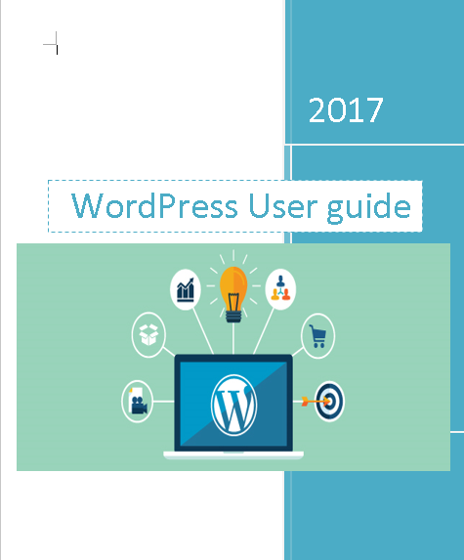
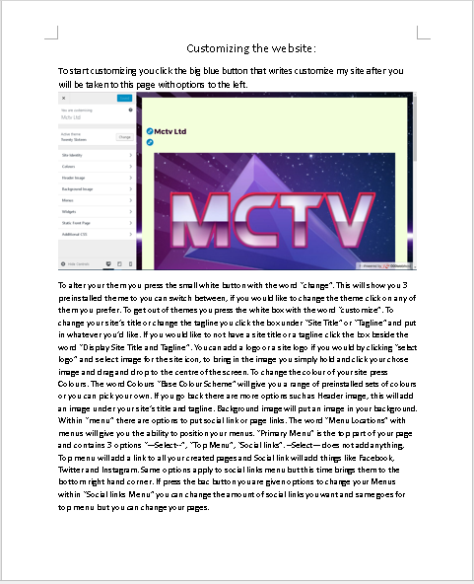
User guides
As Mark of the write my user guide on WordPress.
I detailed many of WordPress’s features such as creating pages and changing themes. Within the User guide I explained a couple of notable internet Jargon such as plugins and links.

Slide 12
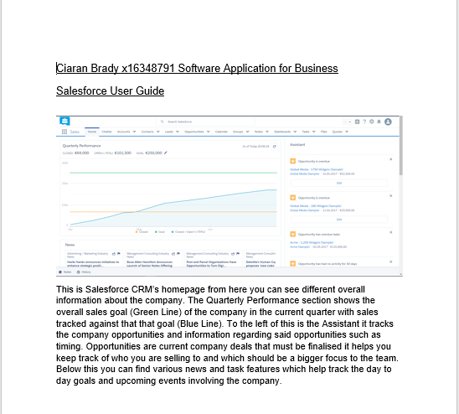
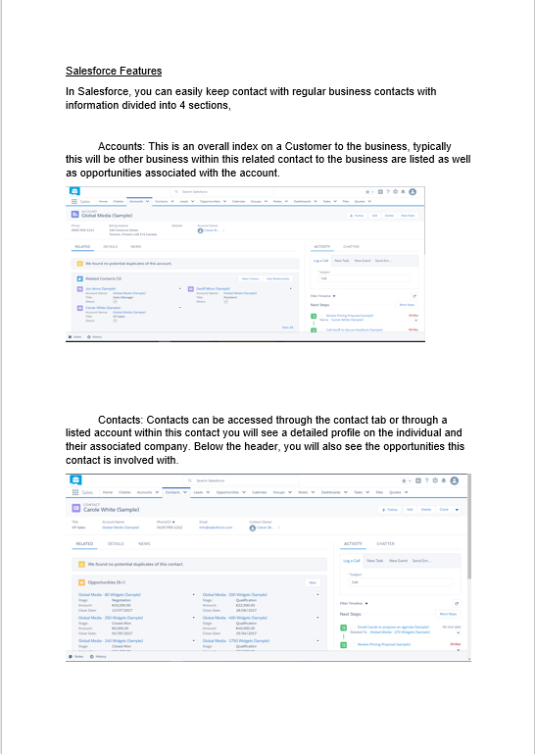
User guides
As Derek of MCTV my user guide on Salesforce.
I detailed the many features of salesforce and explained how the various features link together and are used to create a communication network.

Slide 13

Branding and Colour scheme
Done by Mark

Slide 14
Conclusion
After discussing it as a group, we would recommend that the company invest in WordPress software, this due to all major retailer moving towards the eCommerce direction.
We see the company in the future moving into the online retailers business as the online shop will attract more customers and the company could attract customers through online advertisement such as google adware or Facebook sponsored posts.
Overall we found the project interesting to do as it required a lot of group work and constant communication within the group.

Slide 15

Any Questions

